Slide 1

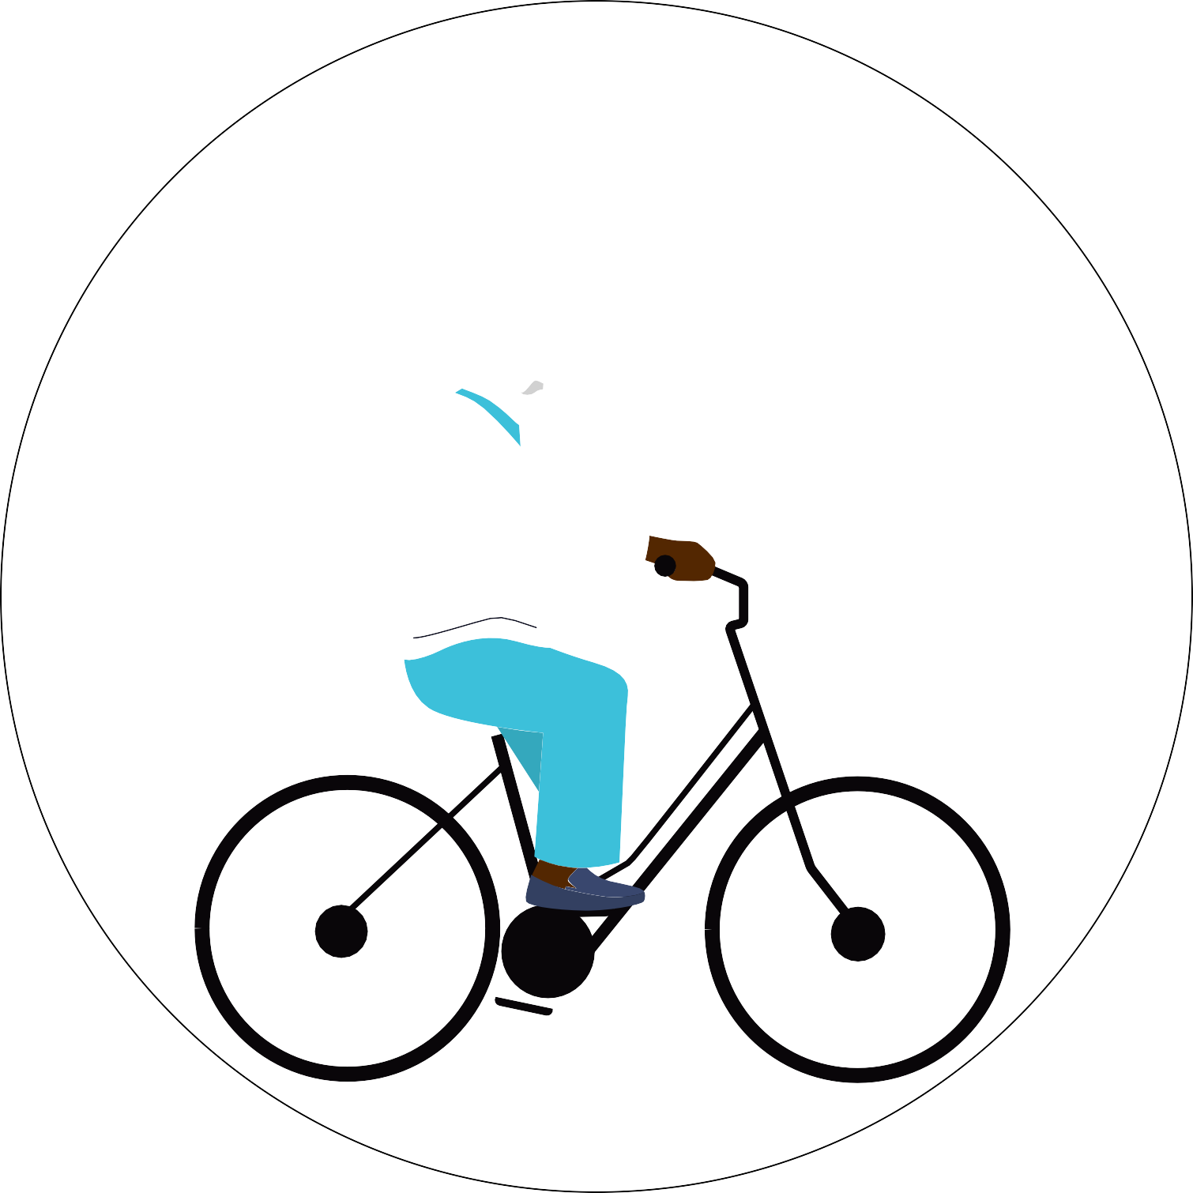










Avatars scenario library Sustainability
DECEMBER 2021

Slide 2











Trees

Slide 3



















Trees

Slide 4






Wind turbines and solar panels

Slide 5















Green housing and energy plants

Slide 6







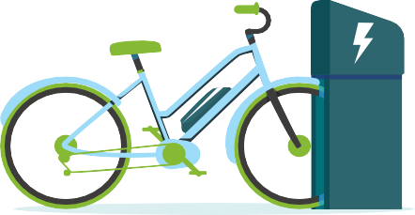
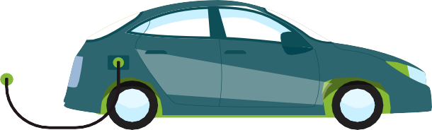
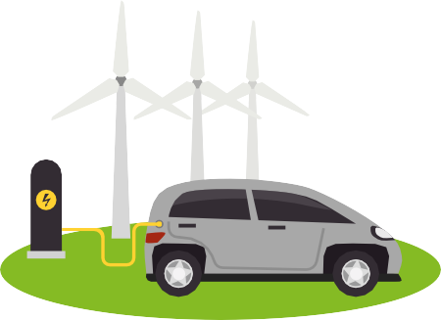
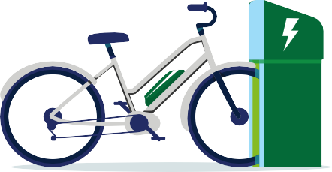
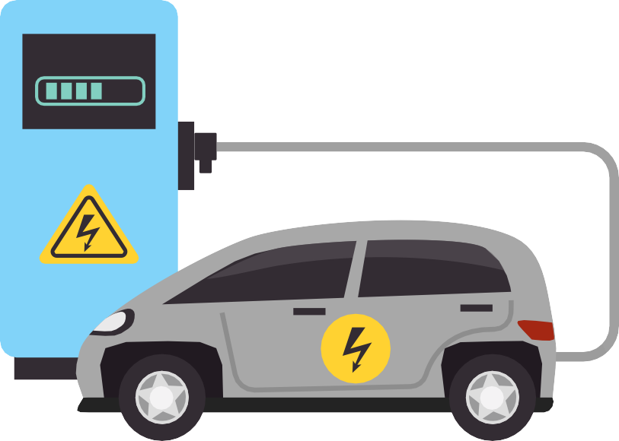
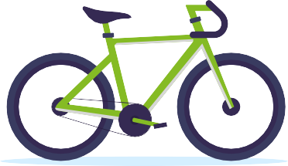

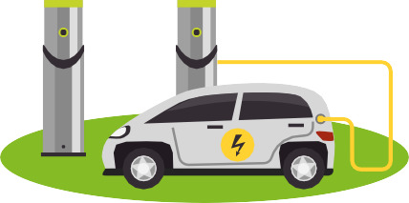







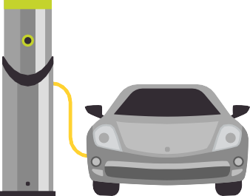
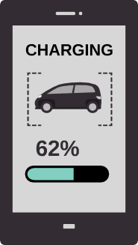
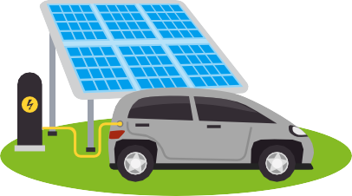







Electric cars and bicycles

Slide 7
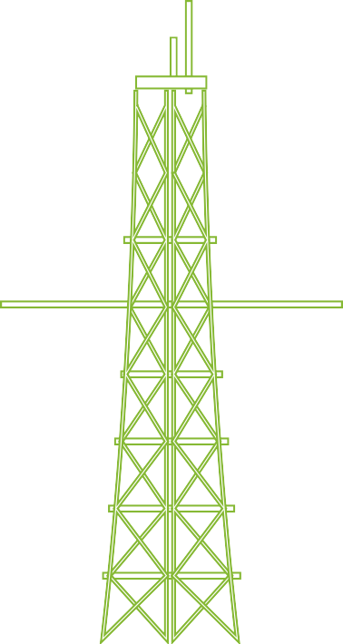












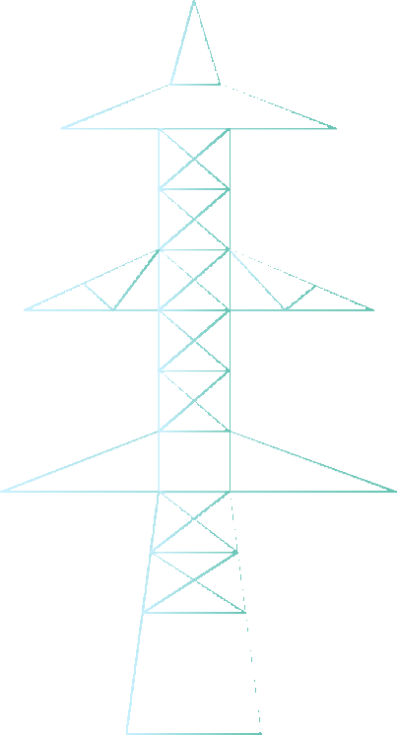





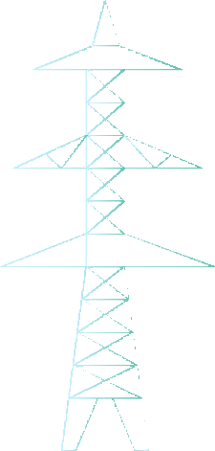












Miscellaneous

Slide 8





Example background scene

Slide 9









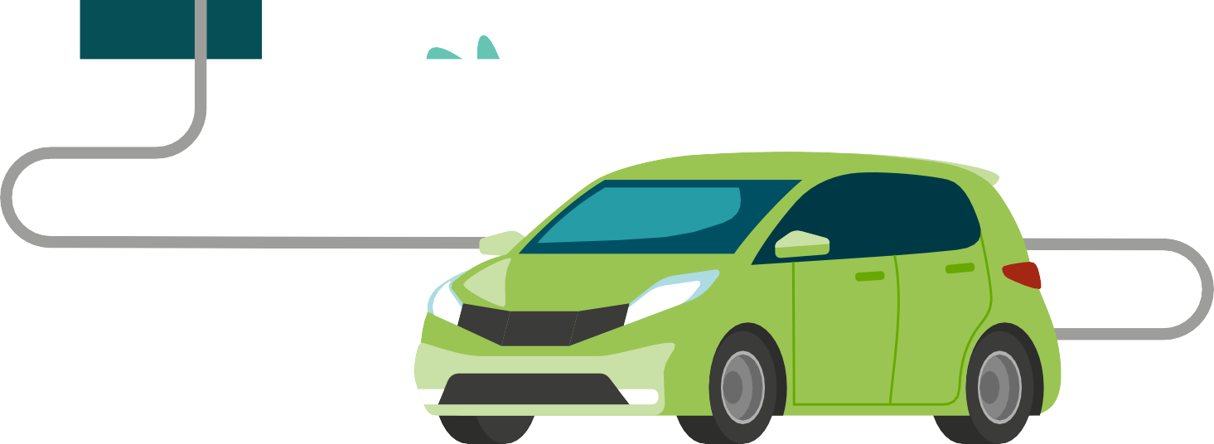
Example background scene

Slide 10

Example background scene

Slide 11


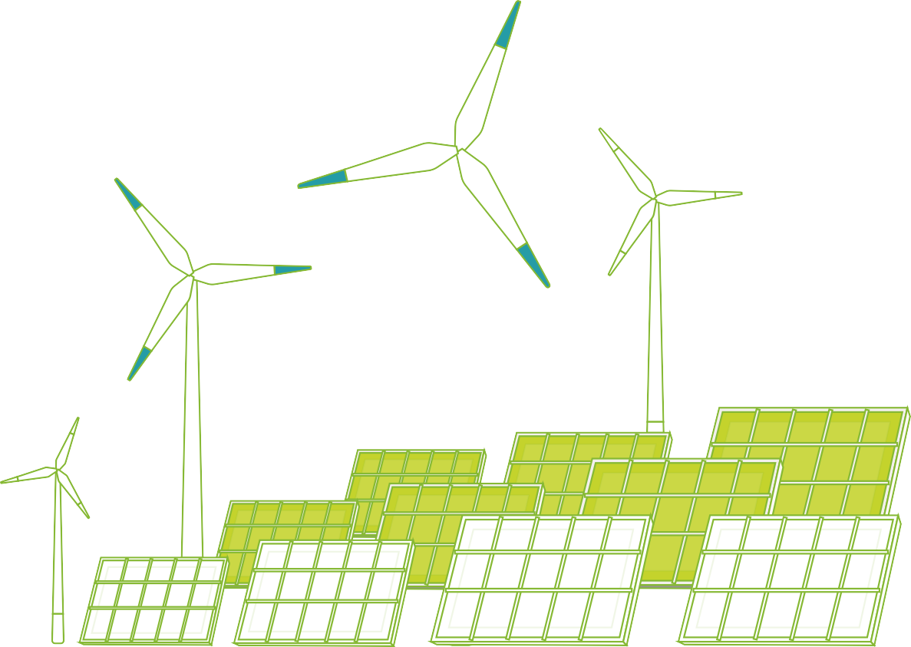

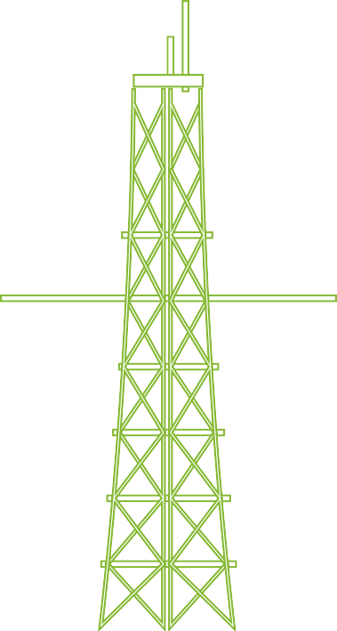


Example background scene

Slide 12


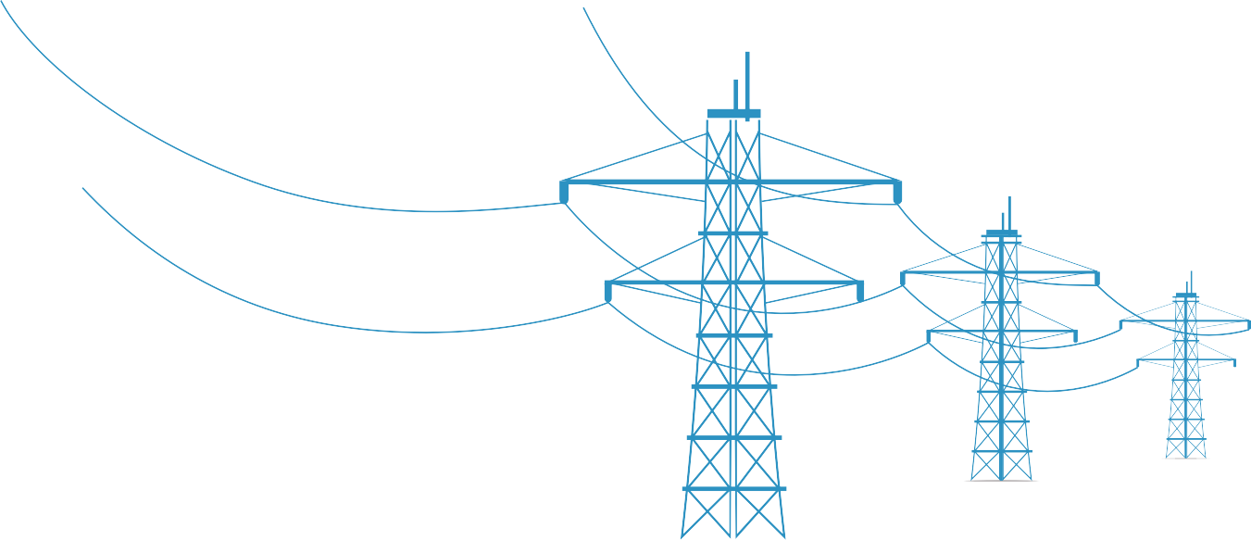






Example background scene

Slide 13

Deloitte refers to one or more of Deloitte Touche Tohmatsu Limited
(collectively, the “Deloitte organization”). DTTL (also referred to as “Deloitte separate and independent entities, which cannot obligate or bind each related entity is liable only for its own acts and omissions, and not those
of each other. DTTL does not provide services to clients. Please see www. deloitte.com/about to learn more.
© 2021. For information, contact Deloitte Touche Tohmatsu Limited.

